Slide 1
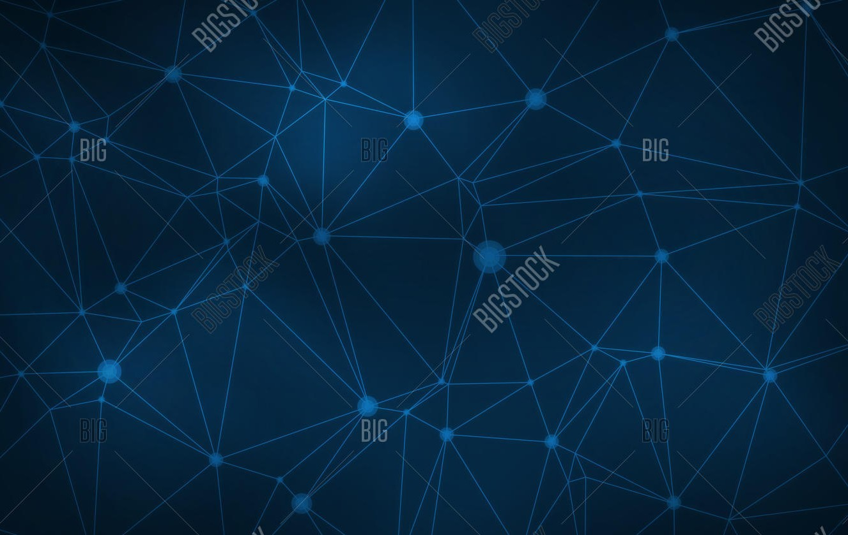

TOPIC:
BE PROJECT PHASE-2
GENERATING A DECENTRALIZED ARCHITECTURE FOR DATA PRIVACY AND SHARING USING BLOCKCHAIN TECHNOLOGY

Slide 2
GROUP 5
TEAM MEMBERS :
ANIRVIN VISHWANATHAN
KANISHKA KOTHARI
AKASH MAHALE
MENTOR:
Dr. PREETIDA JANI

Slide 3
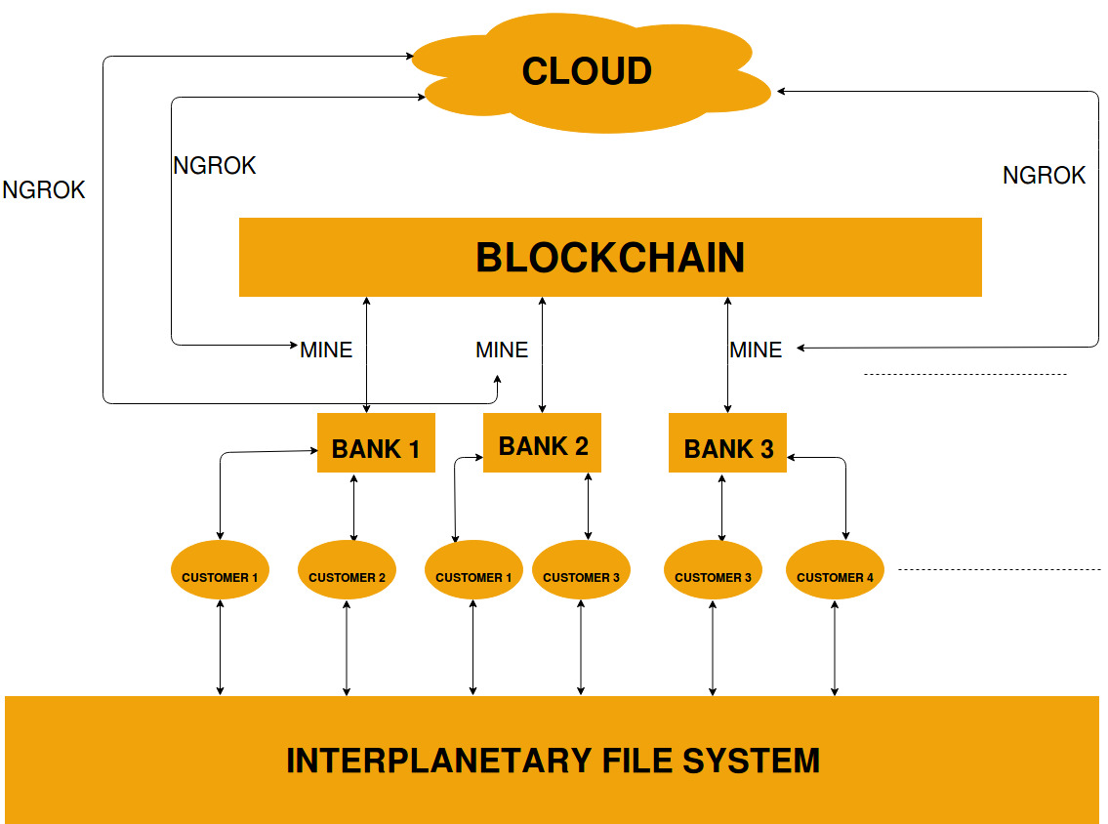
PROPOSED ARCHITECTURE:

Slide 4
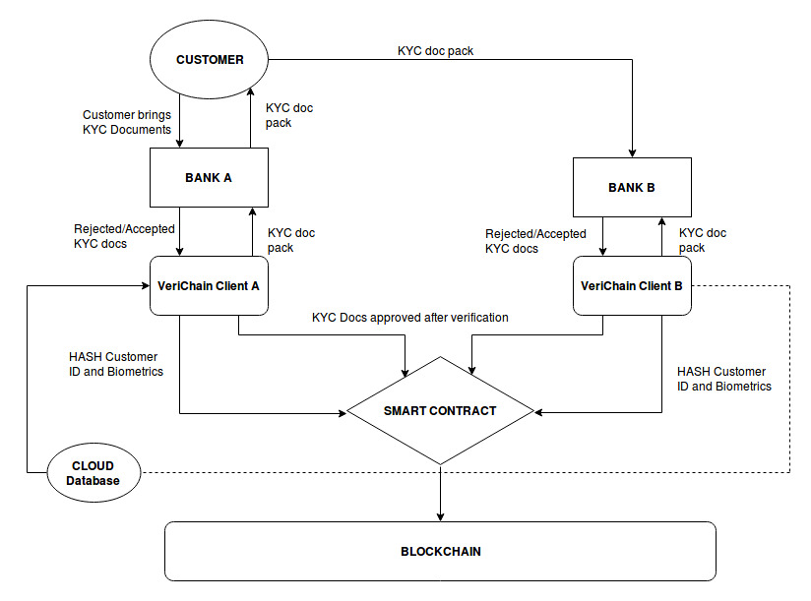

Slide 5
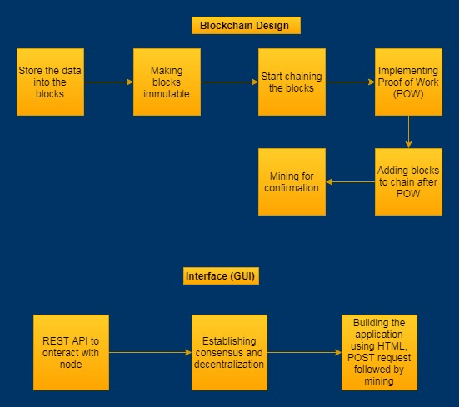
SOFTWARE LOGIC DESIGN:

Slide 6
How Software Logic Design Works? (1 / 4)
1. Store Data into Blocks:
Each Block has a unique ID.
Block will contain data required for KYC process.
2. Making Blocks Immutable:
Hashlib library of Python is used.
SHA-256 is implemented.

Slide 7
How Software Logic Design Works? (2 / 4)
3. Chaining of Blocks :
Chaining the blocks using their hashes.
The previous hash will be stored in the next block.
If content of previous block changes, mismatch will occur.
4. Creation of Genesis (First) Block :
Manually generated by some unique logic.
We passes index=0, an empty transaction array, previous hash= 0 and initialised the time stamp.
This becomes the logic of further blocks that will be added to the genesis.

Slide 8
How Software Logic Design Works? (3 / 4)
5. Implementing Proof of Work :
Task of computing hash is made purposely difficult.
Constraint of 2 leading zeros has been included.
A field called nonce which keeps changing until we get valid hash is added.
6. Mining:
Verify POW.
Keep adding the verified blocks to the chain.

Slide 9
How Software Logic Design Works? (4 / 4)
7. Creating Interfaces or GUI:
We are using FLASK library to create REST-API.
Interacting with nodes will take place via REST-API.
An endpoint is created to submit or post new data.
Basic HTML-CSS is used to make a simple GUI
8. Decentralization :
The application intends to work on multiple nodes.
Thus an endpoint has been created for interaction of various authorised nodes contributing to the Blockchain.
An endpoint that will announce the nodes after updating is created.

Slide 10
Security Drawbacks : (1 / 2)
1. Intentional Manipulation :
The copies of data in the block of a few nodes can be changed.
Becomes difficult to manage multiple nodes.
A consensus algorithm will be required to agree so as to maintain the integrity of the chain.
Consensus Algorithm :
Agreeing upon the longest valid chain whenever a divergence or anomaly is observed amongst the nodes participating in the chain.
Longest chain shall ensure most of the work is done.

Slide 11
Security Drawbacks : (2 / 2)
2. Verification od right user and data:
Anyone can change any name and post any data.
Solutions:
Public-Private key cryptography.
Every user will have a public key (Username) and a private key (Biometrics, passwords,etc.) which act as digital signature.
The transaction will be verified using public key of the user before adding to the block.
Another solution will be to maintain databases like BigchainDB, MongoDB, FlureeDB.

Slide 12
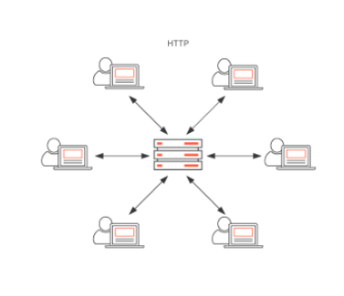
INTER PLANETARY FILE SYSTEM(IPFS) (1 / 2)
HTTP:
Location-based addressing.
It uses IP-addresses.
Process eats bandwidth
Downloads a file from a single server at a time.
Powerful entities can block access to certain locations.

Slide 13
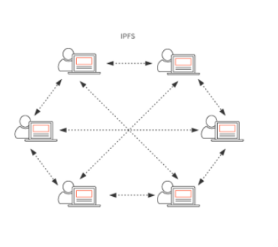
INTER PLANETARY FILE SYSTEM(IPFS) (2 / 2)
IPFS:
IPFS doesn’t have a single point of failure.
Peer-to-peer and distributed file system.
Internet censorship will largely be impossible.
Security also increases — DDos attacks, for example, wouldn’t work.
Speed is another factor that increases.

Slide 14
FURTHER PLANNING
Cloud Setup (AWS OR IBM)
Improving the Front End GUI making it interactive and easy
Biometrics/ Retinal Authentication
Database for IPFS hash and Biometrics
Implementing Consensus
Public Private Key Cryptography

Slide 15
https://github.com/akashmahale237/InterPlanateryKYC.
Project Link

Slide 16
THANK YOU !!

